Slide 1
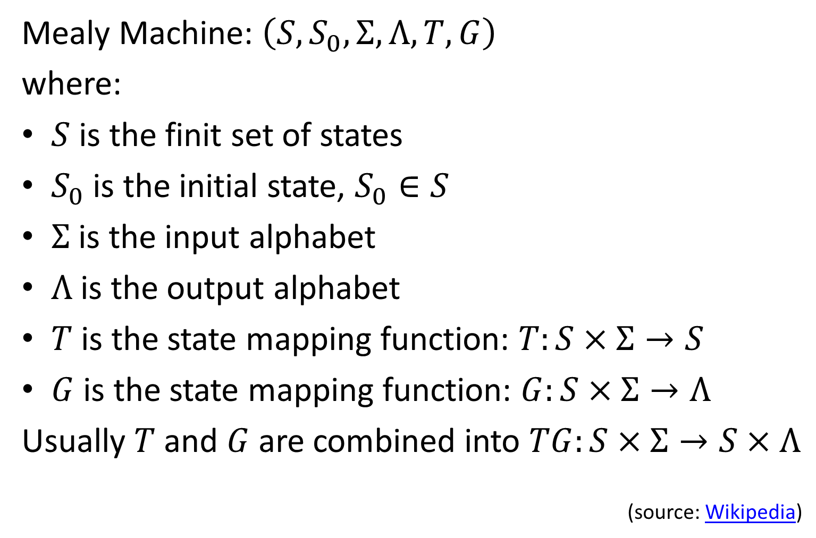
Derivation Component interface
Mealy Machine: $\left(S,S_{0},Σ,Λ,T,G\right)$
where:
$S$ is the finit set of states
$S_{0}$ is the initial state, $S_{0}∈S$
$Σ$ is the input alphabet
$Λ$ is the output alphabet
$T$ is the state mapping function: $T:S×Σ→S$
$G$ is the state mapping function: $G:S×Σ→Λ$
Usually $T$ and $G$ are combined into $TG:S×Σ→S×Λ$
(source: Wikipedia)

Slide 2

Derivation Component interface
$TG:S×Σ→S×Λ$

Slide 3

Derivation Component interface
$TG:S×Σ→S×Λ$
// written in Scala style
type update = S => I => (S, O)

Slide 4
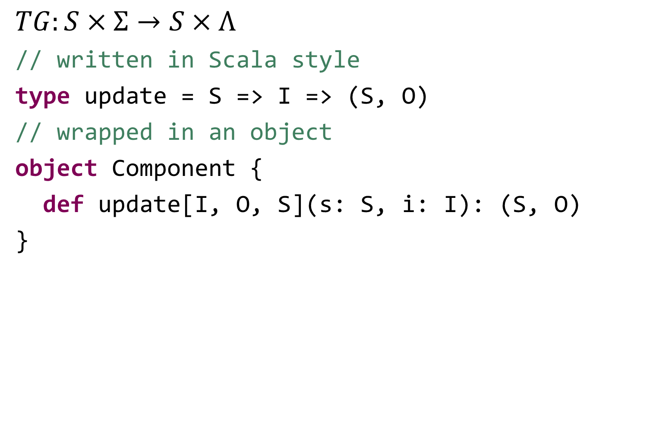
Derivation Component interface
$TG:S×Σ→S×Λ$
// written in Scala style
type update = S => I => (S, O)
// wrapped in an object
object Component {
def update[I, O, S](s: S, i: I): (S, O)
}

Slide 5
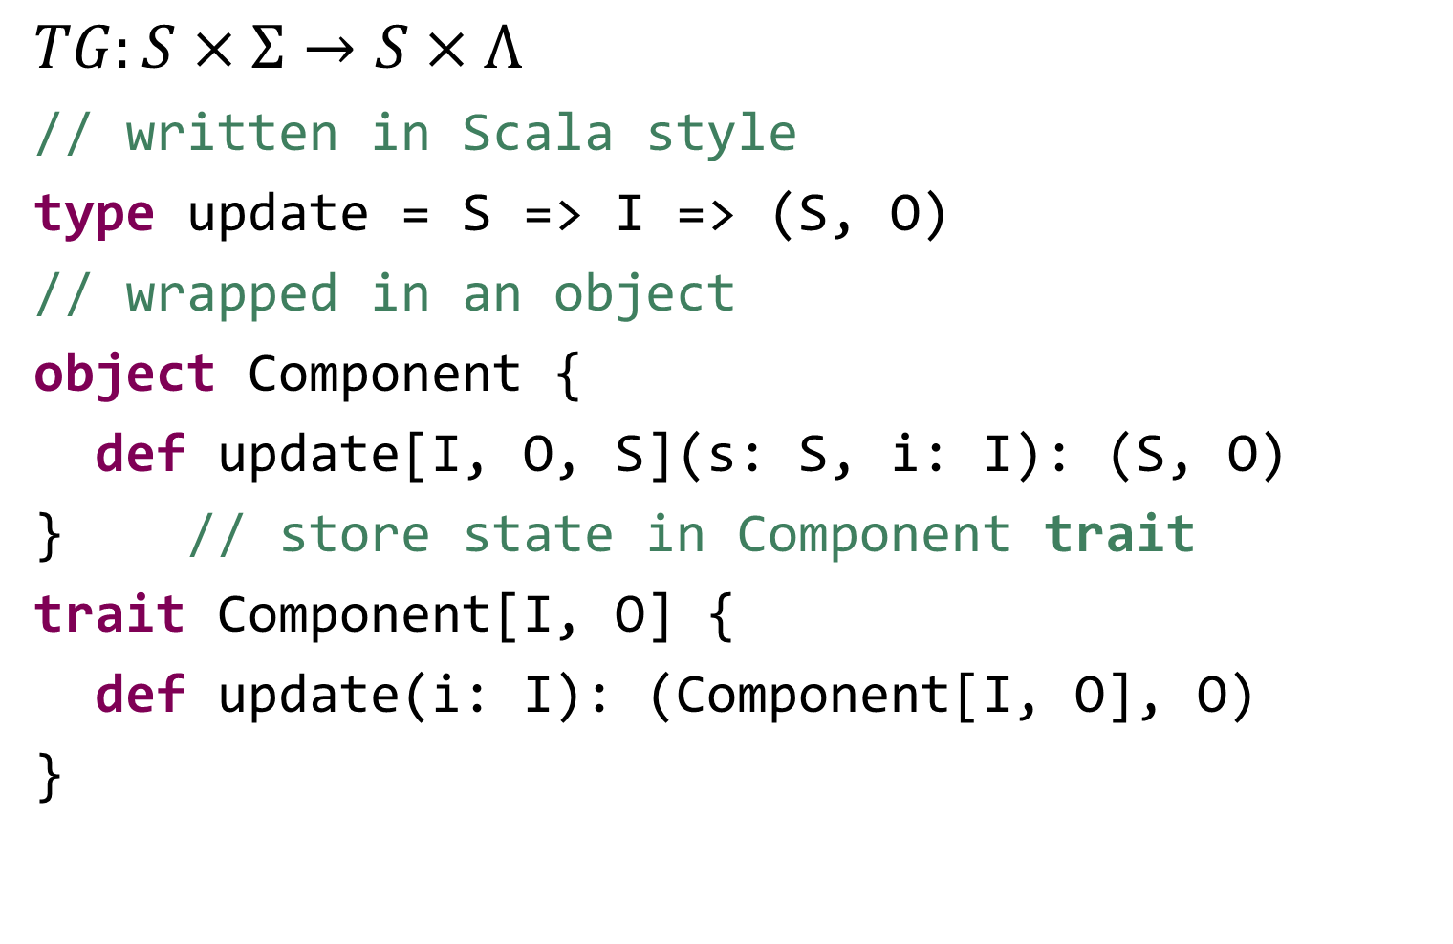
Derivation Component interface
$TG:S×Σ→S×Λ$
// written in Scala style
type update = S => I => (S, O)
// wrapped in an object
object Component {
def update[I, O, S](s: S, i: I): (S, O)
} // store state in Component trait
trait Component[I, O] {
def update(i: I): (Component[I, O], O)
}

Slide 6
Derivation Component interface
trait Component[I, O] {
def update(i: I): (Component[I, O], O)
}

Slide 7
Derivation Component interface
trait Component[I, O] {
def update(i: I): (Component[I, O], O)
} // split output into 2 functions
trait Component[I, O] {
def update(i: I): Component[I, O]
def action: O
} // we call this the immutable Component

Slide 8
Example of a immutable Component
// calculates average over last n inputs
class RunningAverage(n: Int, queue: Queue[Double])
extends Component[Double, Double] {
def update(u: Double): RunningAverage = {
if (queue.length == n) queue.dequeue
queue.enqueue(u)
new RunningAverage(n, queue)
}
def action: Double = queue.sum / queue.length
}

Slide 9
Derivation Component interface
trait Component[I, O] {
def update(i: I): Component[I, O]
def action: O
}

Slide 10
Derivation Component interface
trait Component[I, O] {
def update(i: I): Component[I, O]
def action: O
} // make the state mutable
trait Component[I, O] {
def update(i: I): Unit
def action: O
} // we call this the mutable Component

Slide 11
Example of a mutable Component
// calculates average over last n inputs
class RunningAverage(n: Int)
extends Component[Double, Double] {
val queue = Queue[Double]()
def update(u: Double): Unit = {
if (queue.size == n) queue.dequeue
queue.enqueue(u)
}
def action: Double = queue.sum / queue.length
}

Slide 12
Derivation Component interface
trait Component[I, O] {
def update(i: I): Unit
def action: O
}

Slide 13
Derivation Component interface
trait Component[I, O] {
def update(i: I): Unit
def action: O
} // coproduct
trait Component[I, O] {
def update(i: I): O
}

Slide 14
Derivation Component interface
trait Component[I, O] {
def update(i: I): Unit
def action: O
} // coproduct
trait Component[I, O] {
def update(i: I): O
} // CPS
trait Component[I, O] {
def update(i: I, o: O => Unit): Unit
}

Slide 15
Derivation Component interface
trait Component[I, O] {
def update(i: I, o: O => Unit): Unit
}

Slide 16
Derivation Component interface
trait Component[I, O] {
def update(i: I, o: O => Unit): Unit
} // curry
trait Component[I, O] {
def update(i: I)(o: O => Unit): Unit
}

Slide 17
Derivation Component interface
trait Component[I, O] {
def update(i: I, o: O => Unit): Unit
} // curry
trait Component[I, O] {
def update(i: I)(o: O => Unit): Unit
} // f :: A → B → C == g :: A → (B → C)
trait Component[I, O] {
def update(i: I): (O => Unit) => Unit
}

Slide 18
Derivation Component interface
trait Component[I, O] {
def update(i: I): (O => Unit) => Unit
}

Slide 19
Derivation Component interface
trait Component[I, O] {
def update(i: I): (O => Unit) => Unit
} // (O => Unit) => Unit == Observable[O]
trait Component[I, O] {
def update(i: I): Observable[O]
}

Slide 20
Derivation Component interface
trait Component[I, O] {
def update(i: I): (O => Unit) => Unit
} // (O => Unit) => Unit == Observable[O]
trait Component[I, O] {
def update(i: I): Observable[O]
} // split into 2 methods
trait Component[I, O] {
def in(i: I): Unit
def out: Observable[O]
}

Slide 21
Example of a reactive Component
// calculates average over last n inputs
class RunningAverage(n: Int)
extends Component[Double, Double] {
val queue = Queue[Double]()
val output = Subject[Double]
def in(u: Double): Unit = {
if (queue.size == n) queue.dequeue
queue.enqueue(u)
output.onNext(queue.sum / queue.length)
}
def out: Observable[Double] = output
}

Slide 22
Derivation Component interface
trait Component[I, O] {
def in(i: I): Unit
def out: Observable[O]
}

Slide 23
Derivation Component interface
trait Component[I, O] {
def in(i: I): Unit
def out: Observable[O]
} // actually it has 3 in methods:
// error and completed are possible too
trait Component[I, O] {
def inNext(i: I): Unit
def inError(e: Throwable): Unit
def inCompleted(): Unit
def out: Observable[O]
}

Slide 24
Derivation Component interface
trait Component[I, O] {
def inNext(i: I): Unit
def inError(e: Throwable): Unit
def inCompleted(): Unit
def out: Observable[O]
}

Slide 25
Derivation Component interface
trait Component[I, O] {
def inNext(i: I): Unit
def inError(e: Throwable): Unit
def inCompleted(): Unit
def out: Observable[O]
} // this is the signature of Observer!
trait Component[I, O] extends Observer[I] {
def out: Observable[O]
} // this is like a Subject from I to O!
Observer[I]
transformer I to O
Observable[O]

Slide 26
Derivation Component interface
trait Component[I, O] extends Observer[I] {
val subject = Subject[I]
val observable = subject.publish(transform)
def transform(i: Observable[I]): Observable[O]
def asObservable: Observable[O] = observable
override def onNext(i: I) = subject.onNext(i)
override def onError(e: Throwable) =
subject.onError(e)
override def onCompleted = subject.onCompleted
}

Slide 27
Example of a Component
// calculates average over last n inputs
class RunningAverage(n: Int)
extends Component[Double, Double] {
val queue = Queue[Double]()
def transform(ts: Observable[Double]) =
ts.tee(_ => if (queue.length == n) queue.dequeue)
.tee(queue.enqueue(_))
.map(t => queue.sum / queue.size)
}

